Slide 1
Department of Computer Science and Engineering
I Year CSE- II Semester
Subject: Adaptive Computer Technologies(MR22-1ES0103)
Prepared by
Vikram Kalvala
Asst.Prof.

Slide 2
UNIT-4 Augmented Reality and Virtual Reality
Contents:
Virtual Reality
Augmented Reality
Mixed Reality
Augmented Virtuality
Extended Reality
History
VR Features
VR Controllers
Current issues with VR
AR mobile devices
AR Headsets
AR Glasses
AR Controllers
Current issues with AR
Importance of AR & VR in educational and IT sector

Slide 3
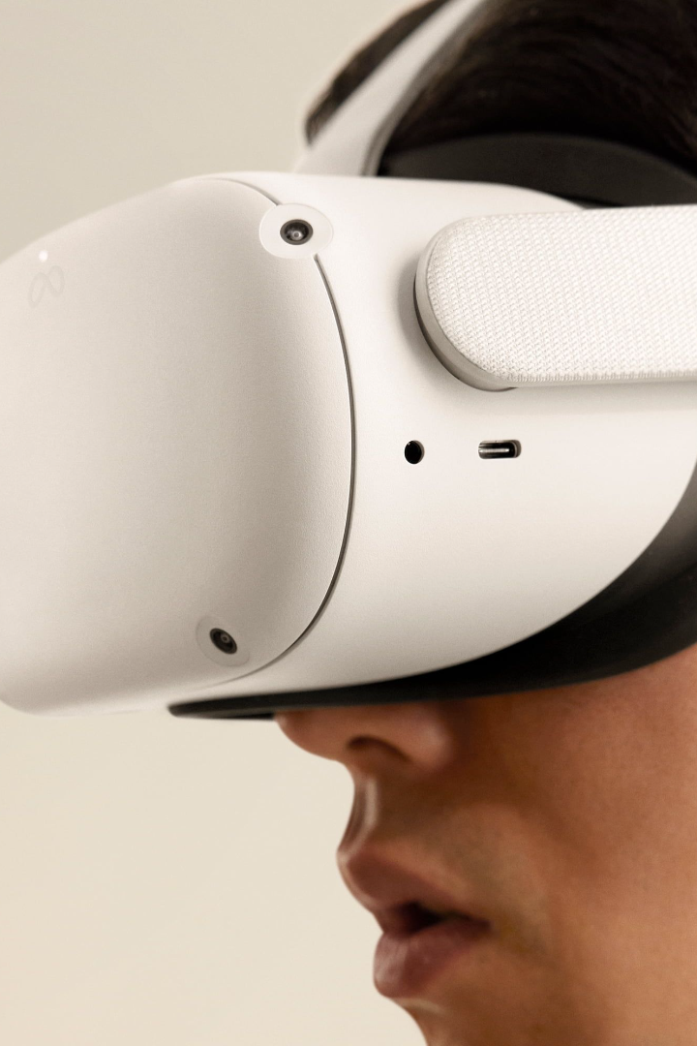
Introduction to AR & VR
1
Definition.
2
Key Components.
3
Applications.
An immersive technology that overlays digital information over the real world or replaces the real world with a simulated one.
Head-mounted displays, cameras, and sensors that track your motions and translate them into virtual experiences.
Gaming,
Education
Healthcare,
Marketing and more

Slide 4
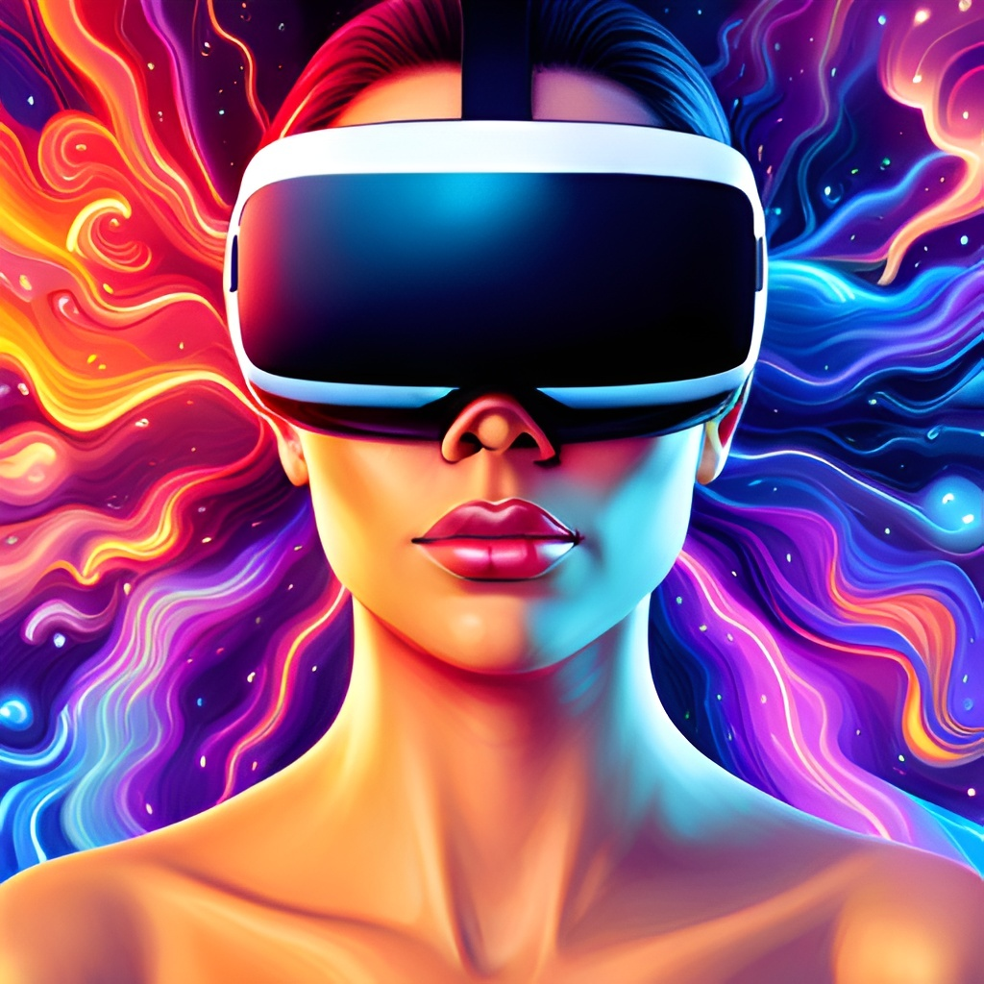
Virtual Reality
Virtual reality refers to the use of computer technology to create a simulated environment. The user can interact with this environment as if it were real. This technology has been around for decades, but recent advancements in hardware and software have made it more accessible to consumers.

Slide 5
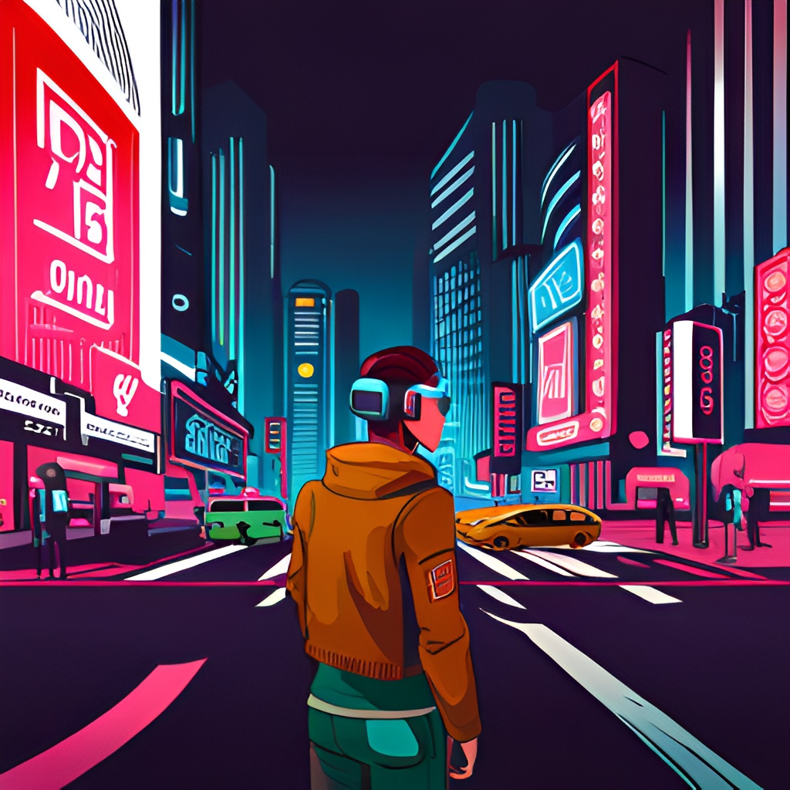
Augmented Reality
Augmented reality (AR) is a technology that overlays digital information onto the real world. Unlike virtual reality, which creates a completely artificial environment, AR enhances the user's perception of reality by adding computer-generated elements to it. This technology has many potential applications, including gaming, education, and advertising.

Slide 6

Mixed Reality
Mixed reality is a type of technology that combines aspects of both virtual and augmented reality to create a unique experience. This technology allows users to interact with virtual objects and environments in real time, creating a seamless blend between the digital and physical worlds.

Slide 7
Uses of Mixed Reality
Use cases for Mixed Reality
Industrial training
Complex procedures
Medical procedures
Education
Benefits of Mixed Reality:
Improved decision-making
Training effectiveness
Remote collaboration
Reduced errors.

Slide 8
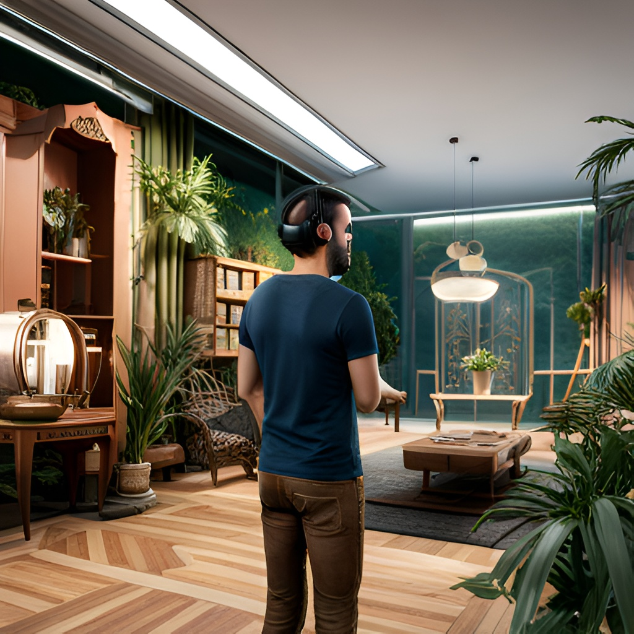
Augmented Virtuality
Augmented virtuality (AV) is a type of mixed reality that primarily involves the use of real-world environments as a base, to which virtual objects are added. In other words, AV is the inverse of augmented reality (AR).
In AR, virtual objects are overlaid onto the real world, whereas in AV, real-world objects are overlaid onto a virtual world. This technology can be used for a variety of purposes, including gaming, education, and training.

Slide 9
Uses of Augmented Virtuality
Use cases for AV:
Virtual product design
Simulation
Remote assistance
Virtual desktops
Entertainment.
Benefits of AV:
Enhanced visualization
3D modeling
Accurate product design
Prototype testing
Improved remote collaboration
Better training outcomes.

Slide 10
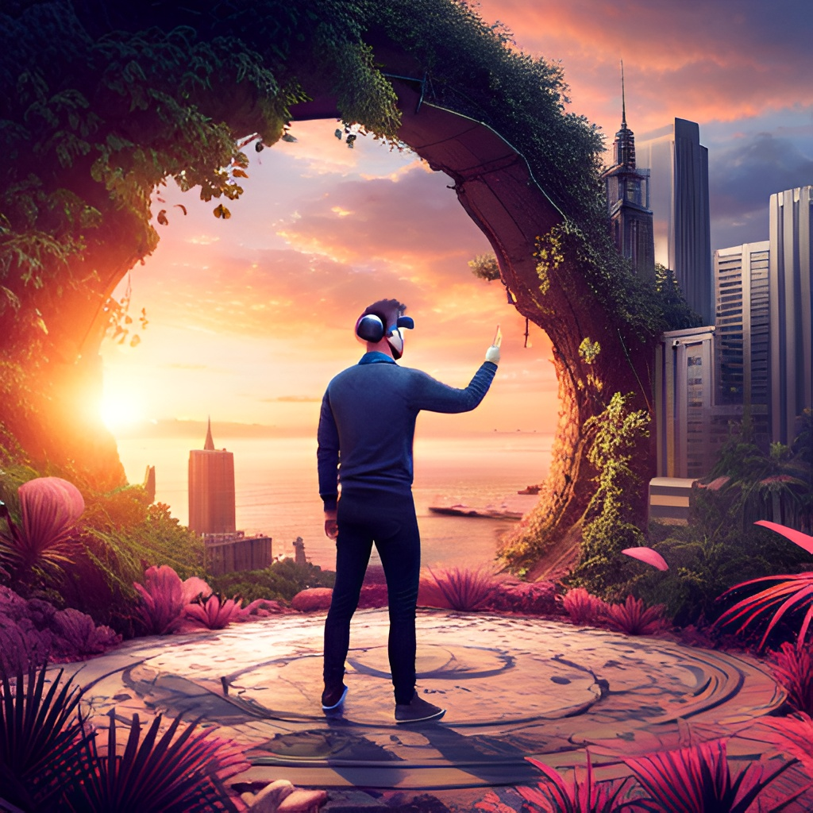
Extended Virtuality
Extended reality (XR) is an umbrella term that encompasses all forms of immersive technologies, including virtual reality (VR), augmented reality (AR), and mixed reality (MR). XR is the next step in the evolution of human-computer interaction, as it allows users to interact with digital content in a more natural and intuitive way. Unlike traditional computing interfaces, which require users to interact with screens and keyboards, XR enables users to interact with digital content in the same way they would interact with the physical world.

Slide 11
Types of Extended Virtuality
There are several types of XR, each with its own characteristics and applications:
Virtual Reality (VR): This type of XR involves the use of a headset or other device to immerse the user in a completely virtual environment. Users can interact with the virtual world using specialized input devices such as VR controllers.
Augmented Reality (AR): This type of XR involves overlaying digital information onto the real world, often through the use of a smartphone or tablet. AR can be used for a variety of applications, including gaming, navigation, and advertising.
Mixed Reality (MR): This type of XR involves blending virtual and real-world elements to create a seamless, interactive experience. MR is often used for applications such as training and simulation, where users need to interact with both digital and physical objects.
Extended Reality (XR): This is the broadest category of XR, encompassing all types of immersive technologies that extend beyond traditional computer interfaces. XR is often used as a catch-all term to refer to immersive technologies in general.

Slide 12
Applications of Extended Reality:
Gaming:
VR Gaming: VR can be used to create immersive gaming experiences that fully transport the player into a virtual world. Games such as Beat Saber, Job Simulator, and Superhot VR have received critical acclaim for their innovative use of VR technology.
Theme Parks: Theme parks such as Disney World and Universal Studios have begun incorporating XR technology into their attractions. For example, the Harry Potter and the Forbidden Journey ride at Universal Studios uses a combination of screens, animatronics, and practical effects to create an immersive experience for riders.
Virtual Concerts: In the wake of the COVID-19 pandemic, many musicians and performers have turned to XR technology to create virtual concerts that can be experienced from anywhere in the world. Artists such as Travis Scott, John Legend, and The Weeknd have all held virtual concerts using XR technology.

Slide 13
Education and training:
Medical Training : XR can be used to create realistic simulations of medical procedures, allowing students to practice in a safe and controlled environment
Flight Training: : XR can be used to create realistic simulations of medical procedures, allowing students to practice in a safe and controlled environment
Military Training: XR can be used to create realistic simulations of combat scenarios, allowing soldiers to train in a safe and controlled environment.
Architecture and Design:
Industrial design : XR can be used to create virtual prototypes of products, allowing designers to explore and refine their designs in a more immersive way.
Real estate: XR can be used to create virtual tours of properties, allowing potential buyers to explore a property in a more immersive way.
Architectural visualization: XR can be used to create virtual models of buildings and other structures, allowing architects to explore and refine their designs in a more immersive way.
Marketing and Advertising:
Product Demonstrations: :XR can be used to create interactive product demonstrations that allow consumers to explore a product in a more immersive way.
Brand activations: : XR can be used to create immersive brand activations that engage consumers in new ways
Advertising: XR can be used to create immersive advertising experiences that allow consumers to interact with a brand in a more engaging way.

Slide 14
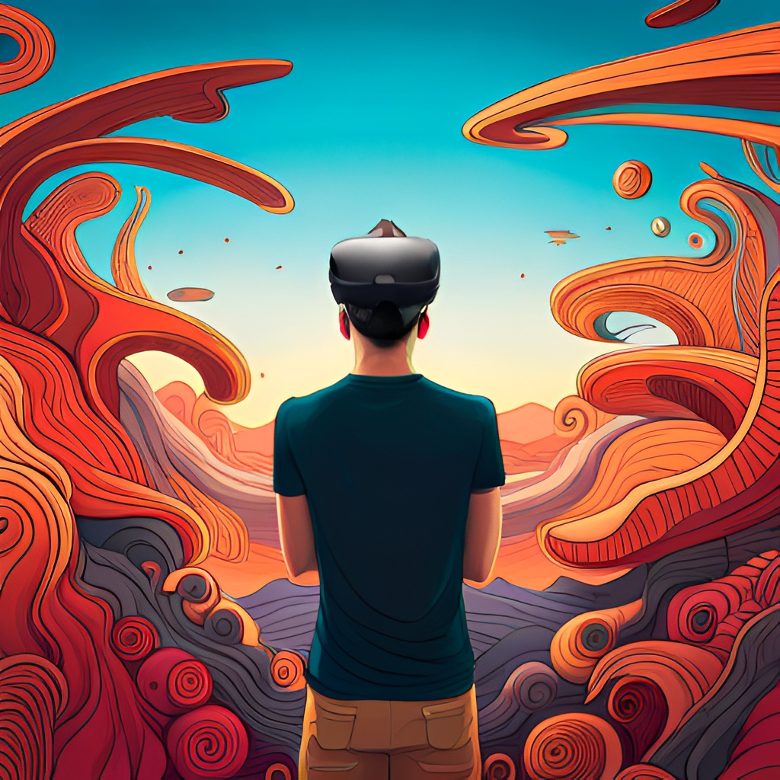
History of AR & VR:
Augmented Reality (AR) and Virtual Reality (VR) have been around for decades, but it was only in recent years that they became mainstream technologies.
The first VR headset was created in the 1960s, but it wasn't until the 1990s that the technology became more affordable and accessible to the public. In the early 2000s, the first AR applications began to emerge, allowing users to overlay information on top of the real world using their mobile devices.
In 2012, the first modern VR headset, the Oculus Rift, was introduced, which was a major breakthrough for the technology. Since then, both AR and VR have continued to evolve and improve, with more and more applications and use cases emerging every day.

Slide 15
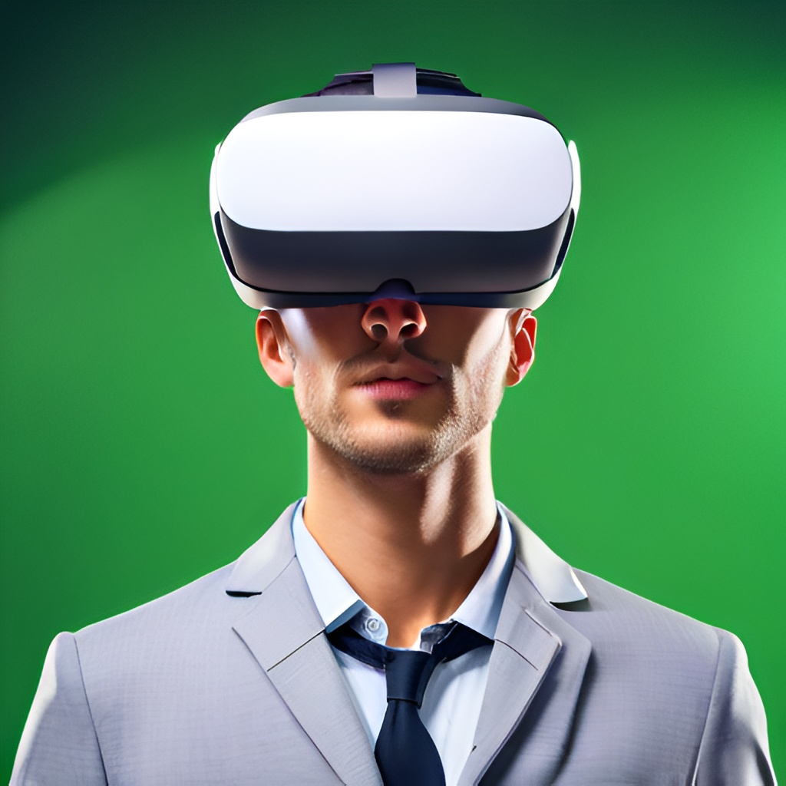
Features of VR:
The most important features of VR is its ability to track user movements and adjust the virtual environment accordingly. This allows users to move around and interact with objects in a natural and intuitive way, making the experience much more realistic.
Another key feature of VR is its ability to create highly detailed and realistic environments. Modern VR systems use high-fidelity graphics and advanced rendering techniques to create lifelike worlds that are almost indistinguishable from reality. This level of realism allows users to fully immerse themselves in the virtual environment, making it feel like they are actually there.

Slide 16
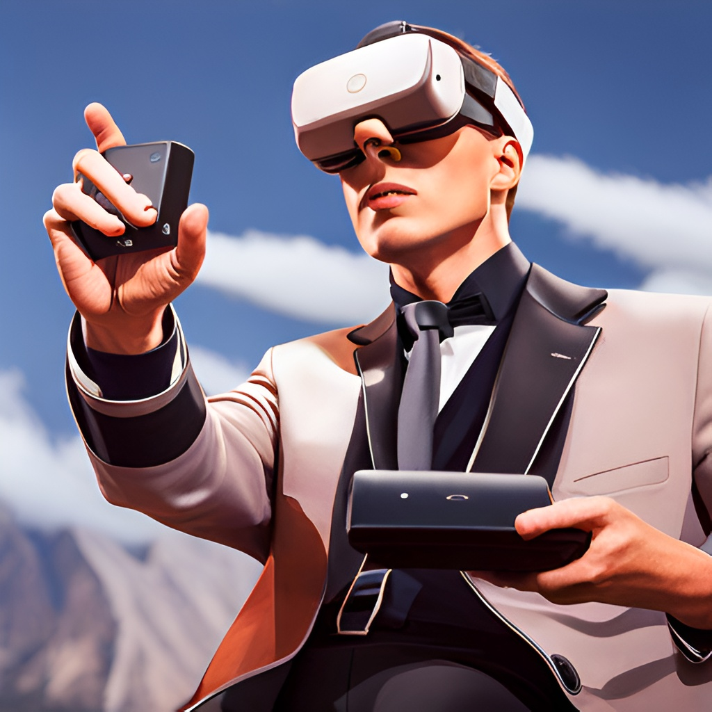
VR Controllers:
Virtual Reality (VR) controllers are an essential component of any VR system. They allow users to interact with the virtual environment in a natural and intuitive way, making the experience much more immersive and engaging. There are several types of VR controllers available on the market, each with its own unique features and capabilities.
Some VR controllers use motion tracking technology to detect the user's movements and translate them into corresponding actions in the virtual environment

Slide 17
Types of VR Controllers:
There are several types of VR controllers available, each with their own strengths and weaknesses:
Wand Controllers: These are the most common type of VR controllers, and are typically used with systems such as the HTC Vive and Oculus Rift. They include a joystick, trigger, and several buttons, and are designed to be held like a wand.
Gesture-Based Controllers: These controllers use sensors to track the user's hand movements and translate them into virtual actions. They are typically used with systems such as the Leap Motion and Microsoft Kinect.
Gun Controllers: These controllers are designed to simulate the experience of holding a gun, and are typically used with first-person shooter games. They often include a trigger and additional buttons for reloading and switching weapons.
Specialty Controllers: These controllers are designed for specific applications, such as flight simulators or driving games. They often include specialized buttons or controls for specific actions.

Slide 18
Current issues with VR:
Despite the many advancements in VR technology, there are still several issues that need to be addressed. One of the biggest challenges is motion sickness. Many users experience discomfort and nausea when using VR headsets for extended periods of time. This is due to a mismatch between the user's visual and vestibular systems, which can cause confusion and disorientation.
Another issue with VR is the limited field of view. Most VR headsets have a relatively narrow field of view, which can detract from the overall immersion of the experience. Additionally, the resolution of VR displays is still not as high as traditional monitors, which can make text and fine details difficult to read.

Slide 19
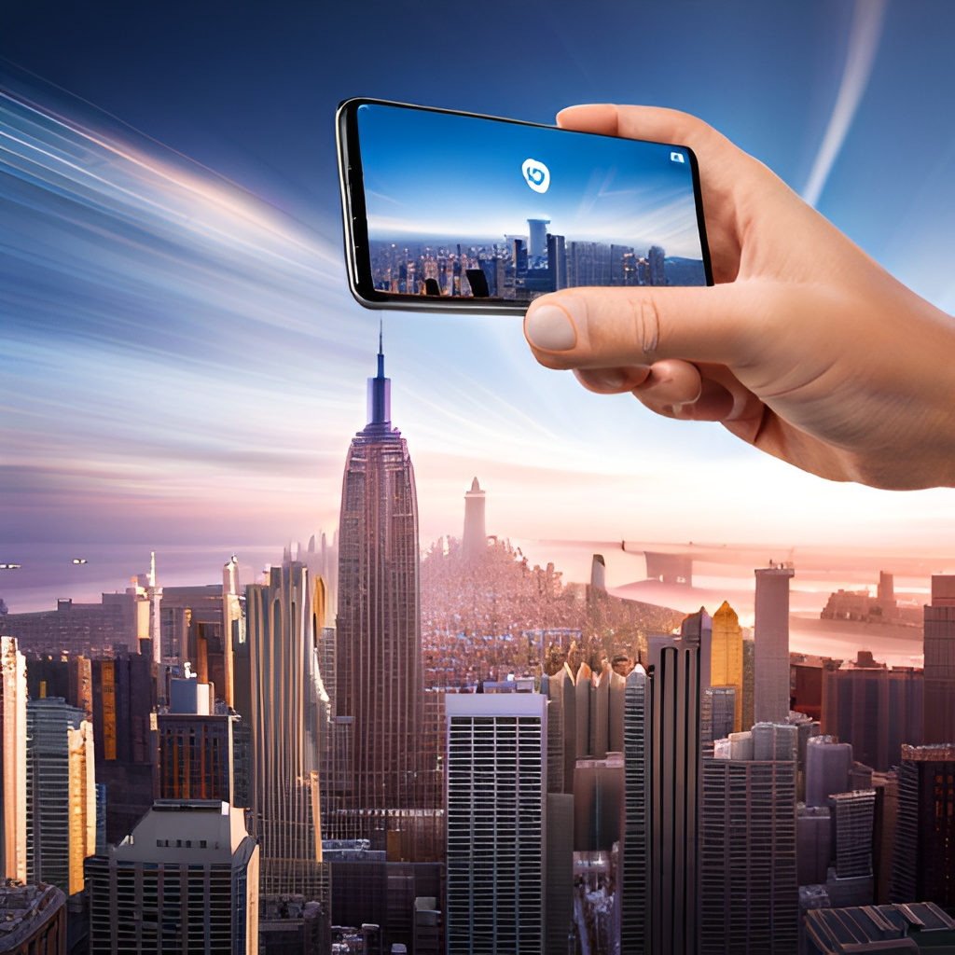
AR Mobile Devices:
AR (Augmented Reality) technology is becoming increasingly popular, and one of the main platforms for AR experiences are mobile devices. AR mobile devices use a combination of camera and software to overlay digital content onto the user's real-world environment. This allows for a wide range of applications, from gaming and entertainment to education and training.
One of the benefits of AR mobile devices is that they do not suffer from the same motion sickness issues as VR headsets.

Slide 20
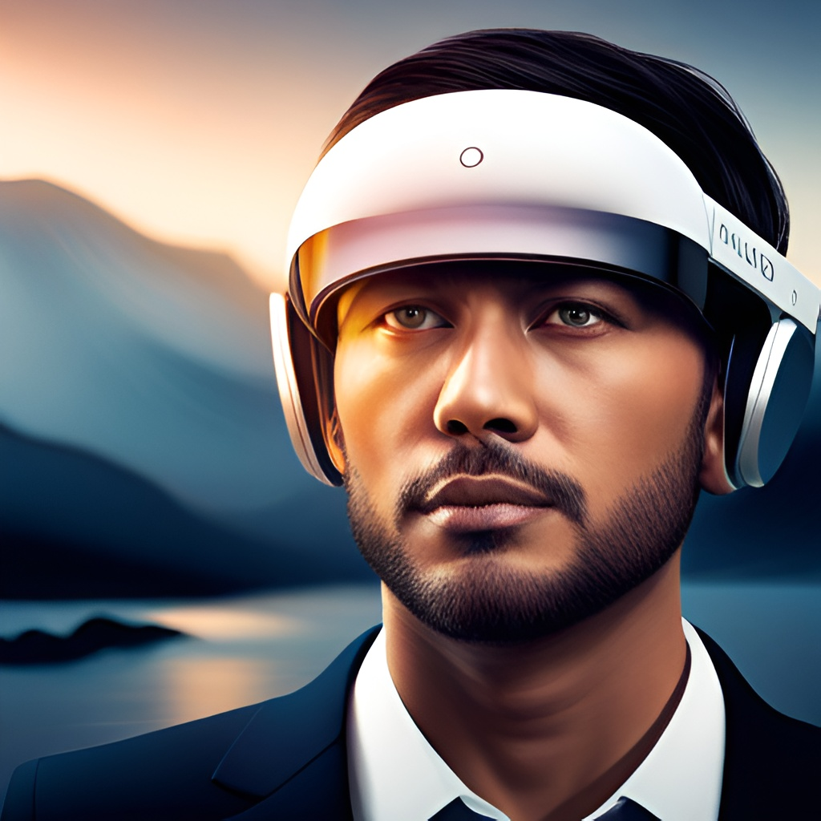
AR Headsets:
AR headsets are wearable devices that use AR technology to overlay digital content onto the user's real-world environment. Unlike AR mobile devices, AR headsets offer a more immersive experience by providing a larger field of view and allowing users to move around in their environment without having to hold up a device.
AR headsets come in various forms, from standalone devices like Microsoft's HoloLens to tethered devices like the Magic Leap One

Slide 21
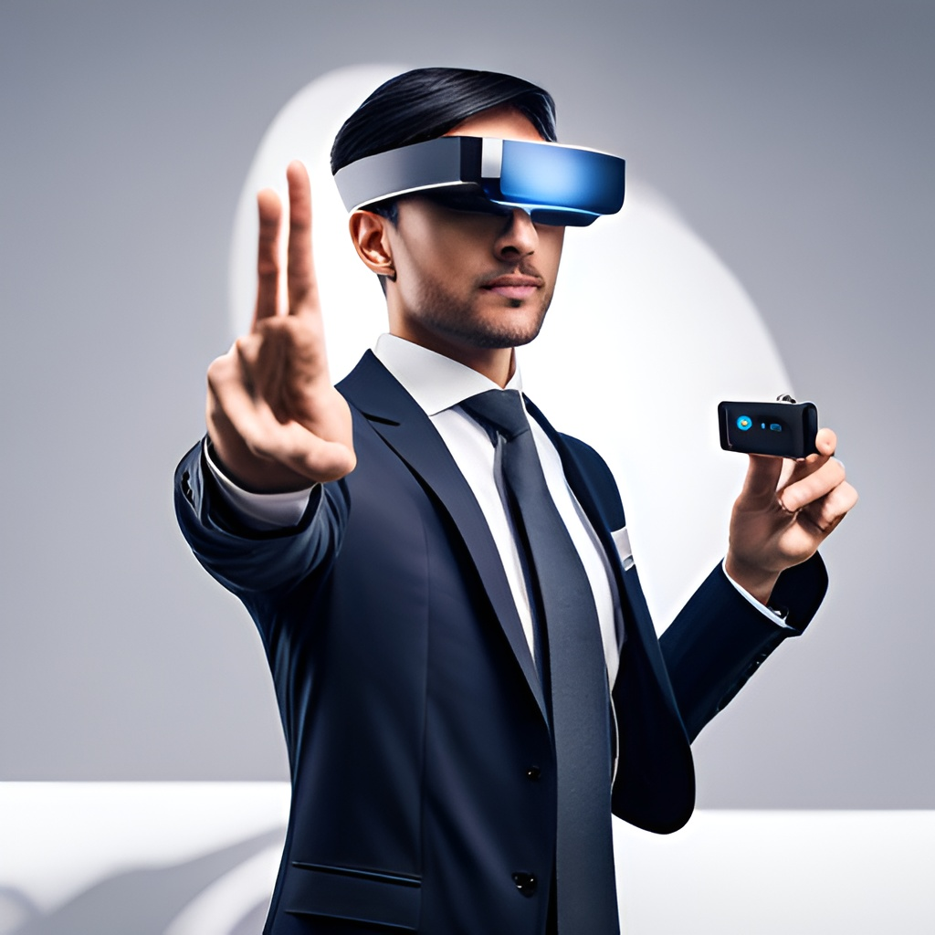
AR Glasses:
AR glasses are wearable devices that use AR technology to overlay digital content onto the user's real-world environment. These glasses offer a more seamless experience as they allow users to have their hands free while interacting with the augmented reality. AR glasses come in various forms, from standalone devices like Google Glass to add-on kits for existing glasses like North's Focals.

Slide 22
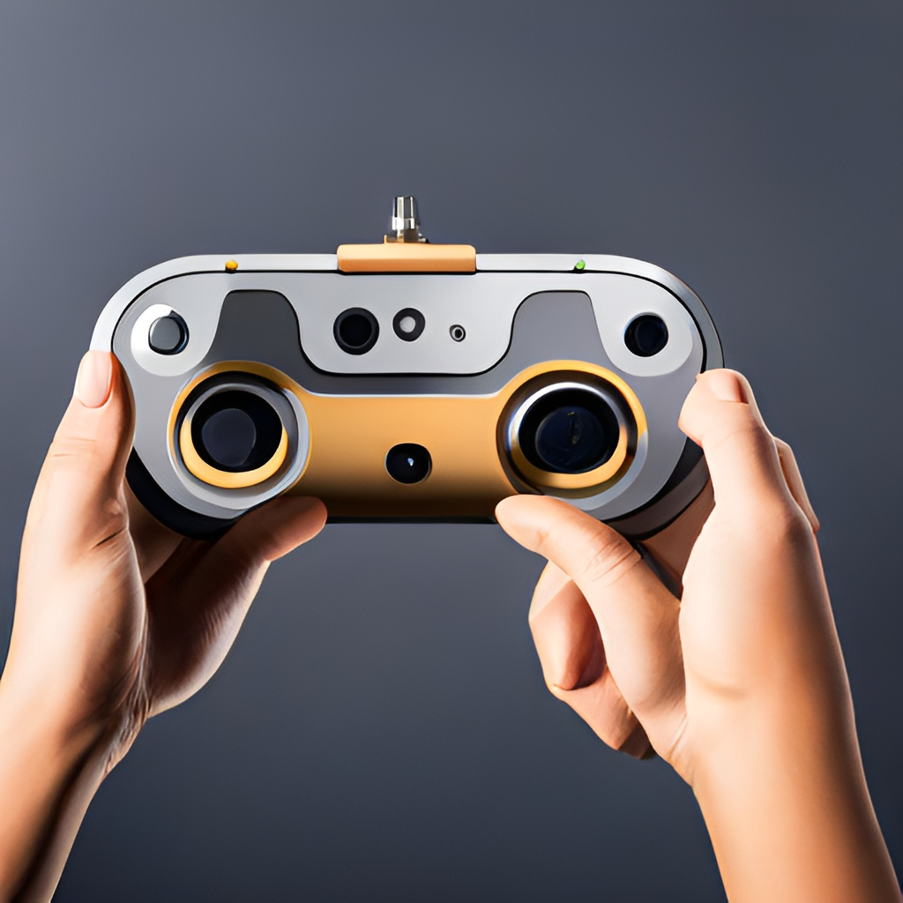
AR Controllers:
AR controllers are handheld devices that allow users to interact with the virtual objects in their augmented reality environment. These controllers can range from simple handheld devices with buttons and joysticks to more complex devices like Microsoft's HoloLens 2 hand tracking system. AR controllers provide a more tactile and immersive experience, allowing users to manipulate virtual objects as if they were real.

Slide 23
Current Issues of AR:
Cost and Complexity:
AR systems can be expensive and complex to implement, requiring specialized hardware and software. This can make it difficult for smaller businesses to adopt these technologies, limiting their potential benefits.
Technical Limitations:
AR systems can be limited by technical factors such as latency and resolution, which can affect the overall quality of the experience. This can be particularly problematic for applications such as gaming, where a high level of performance is required
Health and Safety Concerns:
AR and VR can cause a range of health and safety concerns, such as motion sickness, eye strain, and disorientation. This can be particularly problematic for users who have existing medical conditions or who are prone to certain types of motion sickness.

Slide 24
Privacy Concerns:
AR and VR systems can raise privacy concerns, as they often involve the collection and processing of large amounts of data about users. This can be particularly problematic for applications such as virtual meetings and remote collaboration, where sensitive information may be shared.
Social Isolation:
AR and VR can contribute to social isolation, as users may become more engrossed in the virtual world and less connected to the real world. This can be particularly problematic for users who spend large amounts of time in virtual environments, such as gamers or remote workers

Slide 25
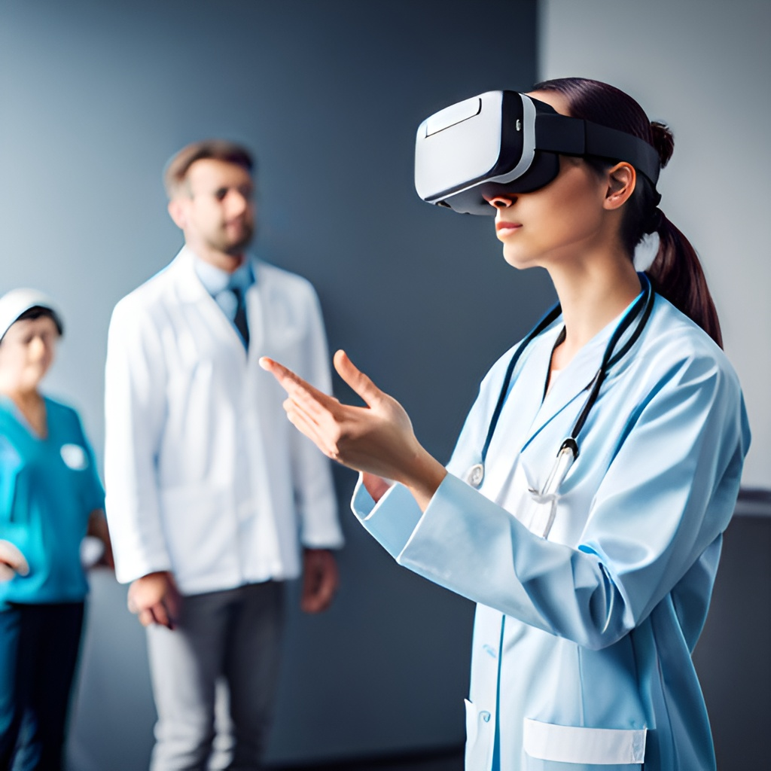
The Importance of AR and VR Educational and health sectors
AR and VR have become increasingly popular in a variety of industries, from gaming to healthcare. In gaming, these technologies offer immersive experiences that transport players to new worlds. In education, AR and VR can provide interactive and engaging learning experiences. In healthcare, they can be used for training and simulation purposes. And in marketing, they offer new and creative ways to engage with customers.

Slide 26
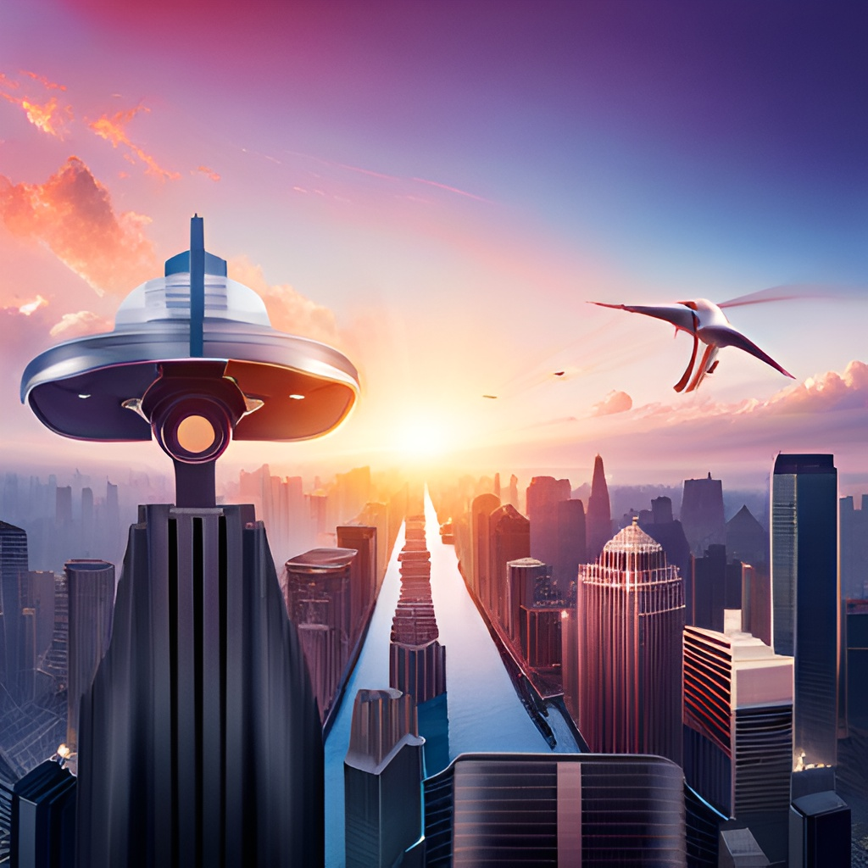
The Importance of AR and VR in the IT Sector
AR and VR have numerous applications in the IT sector. For example, they can be used for virtual meetings and remote collaboration, allowing teams to work together from different locations. They can also be used for product design and prototyping, providing a more immersive and interactive experience. In addition, they can be used for training purposes, allowing employees to learn new skills in a more engaging and interactive way.

Slide 27
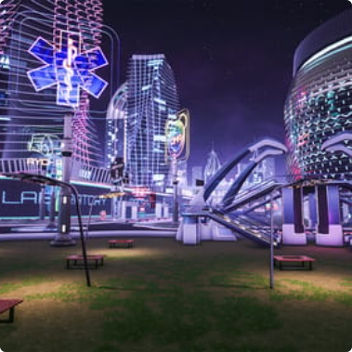
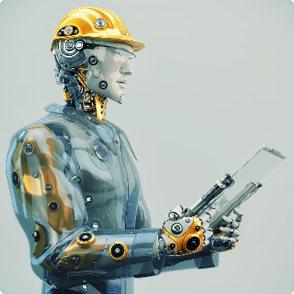
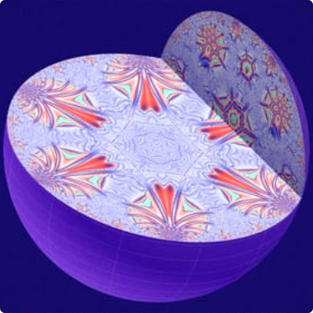
Future of A.R and V.R technology
The Future of AR
The Future of VR
The Future of MR and XR
Applications for AR in smart cities, navigation, telemedicine, and more.
Uses for VR in manufacturing, training, sports, and travel.
Applications for MR and XR in scientific research, education, entertainment, and product design.

Slide 28
THANK YOU

